Slide 1
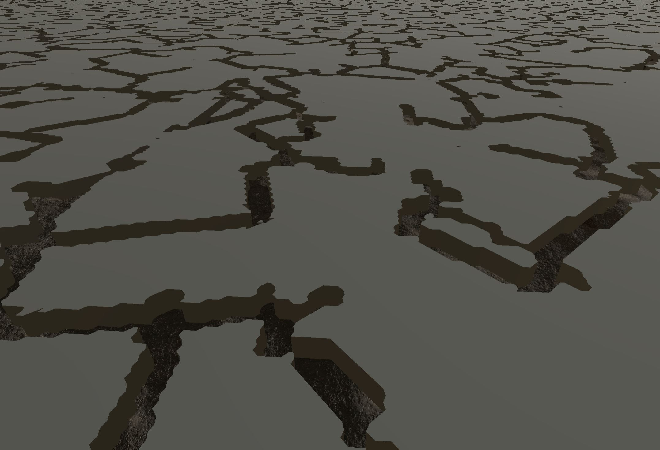
Mythic Labyrinth Recap
by. Thomas Gilman

Slide 2
Pitch
Procedurally generated
Labyrinth
Fantasy
RPG

Slide 3
Milestones
Procedurally generated perfect maze
Basic controls and hit detection
Scoring system
Ambience
Base game play
Dynamic environment
Third person gameplay
Enemy AI

Slide 4
Road Blocks
Unity’s Inspector
Applying Textures to UV’s
Placement of objects in maze
Optimizing Code
Time management

Slide 5
Future Goals
Variations in level layout
Floor and ceiling mesh’s
Objects to interact with
Enemies
Player model and Animations
More Textures
Sound

